Slide 1


Work Related learning
LO2-. Demonstrate the prospects of entering a chosen sector or industry as a career pathway
Week 6-

Slide 2

Last session recap (10 minutes)
Students ….
1-Explored different career pathways in health and social care industry.
Described the functions of health and social care service

Slide 3
Aim ; To Explore chosen sector or industry as a career pathway.
Learning Outcomes ;
To explore how covid 19 has impacted the career prospects for health and social care
Covid-19: risks to healthcare workers and their families

Slide 4
Following the outbreak of the COVID-19 pandemic, to explore the potential impact of the first wave of the pandemic on the future supply of nurses in England.
COVID-19 has provoked substantial change across the nursing supply system that is likely to have implications for both those considering a career in nursing and current and former nurses from all sectors.
The shifts will take more time to quantify and understand, but the most significant changes are noted to be increases in workload and stress on nurses, new ways of working and changes in perceptions of the nursing profession on the part of both the public and nurses themselves.
COVID-19 pandemic

Slide 5
Since the beginning of the coronavirus 2019 (covid-19) pandemic, healthcare workers have shown a remarkable resilience and professional dedication despite a fear of becoming infected and infecting others
Impact of covid 19 on Healthcare
Covid-19: risks to healthcare workers and their families

Slide 6
What sectors has COVID-19 affected?
The graduate labour market has suffered significant damage, particularly in the arts - but things are far worse for non-graduates.
Many key graduate employment sectors - in health, social care, IT, business services - have been much less affected than other areas of the economy.
And it's notable that many vacancies that were hard to fill before the pandemic are in that group.
Of the top five graduate professions for the number of hard-to-fill vacancies only HR and recruitment has clearly seen a very serious fall in demand.
Nursing, medicine, IT and housing/welfare are all still in demand.

Slide 7
Hard-to-fill and skills shortage vacancies
The report highlighted the professional level occupations, which were reported by employers to have experienced the most vacancies during the survey. 'Professional level' means managerial, professional and associate professional roles.
Nursing came top of the list, followed by HR and industrial relations professionals, business sales executives, welfare and housing associate professionals and IT user support technicians.
The report also demonstrates that despite thousands of graduates entering the job market every year employers still find certain positions difficult to fill. An employer reported a vacancy as hard to fill if they found it difficult to recruit for, for any reason

Slide 8
Occupational shortages by region
The UK is not one homogenous labour market and workers are not infinitely mobile, therefore local shortages exist.
In the East Midlands, like in most regions, nursing has the most hard-to-fill vacancies.
However, draughtsperso
ns and product and clothing designers are particular to the region.
The East of England has the longest list of shortage occupations and these include medical practitioners, nurses, design and development engineers, veterinarians and business executives.

Slide 9
With a large and business-oriented labour market it's unsurprising that London's appetite for business support professionals in IT, recruitment, consultancy, law, sales and marketing is reflected by shortages in these occupations.
The top four shortages in the North East include nurses, medical practitioners, human resources and industrial relations officers and programmers and software development professionals. The region also struggles to recruit graphic designers.
The North West has more hard-to-fill vacancies in sales than any other. It also has one of the most serious shortages of nurses, recruitment professionals, housing professionals, youth workers and accountants.

Slide 10
The South East has a strong graduate labour market. However, the region has the largest number of shortages in the UK in nursing, IT support, insurance and housing.
Solicitors and legal professionals are in particular short supply in the South West. Other shortage occupations include medical practitioners and programmers and software development professionals.
There are notable engineering shortages in the West Midlands. Sales staff, nurses and human resources and industrial relations officers are also in short supply.
Yorkshire struggles to recruit electrical engineers, IT operations technicians and child and early years officers. Marketing associate professionals are also hard to find.

Slide 11
Health-care workers are known to be at risk for anxiety, depression, burnout, insomnia, moral distress, and post-traumatic stress disorder.
2, 3 Under usual working conditions, severe burnout syndrome affects as many as 33% of critical care nurses and up to 45% of critical care physicians.
Extrinsic organisational risk factors—including increased work demands and little control over the work environment—and the trauma of caring for patients who are critically ill have been heightened by the COVID-19 pandemic and represent important exacerbating factors for poor mental health among health-care workers.

Slide 12
The impact COVID-19 will have on nurse supply is very uncertain. The research shows that the pandemic will have a different impact on individuals and their career decisions depending on a number of factors, such as their experience during the pandemic, personal circumstances, age and ethnicity.

Slide 13
The NHS is the largest employer in England, with nearly 1.2 million full-time equivalent (FTE) staff working in hospital and community services. NHS hospitals, mental health services and community providers are now reporting a shortage of nearly 84,000 FTE staff, severely affecting key groups such as nurses, midwives and health visitors.
General practice is also under strain with a shortage of 2,500 FTE GPs; projections suggest this shortages of GPs and other staff working in primary care and community services are putting ambitions to deliver more care out of hospitals at risk.
gap could increase to 7,000 within five years if current trends continue (Beech et al 2019).

Slide 14
Unfilled vacancies increase the pressure on staff, leading to high levels of stress, absenteeism and turnover. This has been compounded by the Covid-19 pandemic which has exacerbated long term issues such as chronic excessive workload, burnout and inequalities experienced by ethnic minority staff.

Slide 15
A second component of system resilience will be the impact on the workforce. Before the pandemic, the NHS and social care system both had significant staffing shortages. Stress levels for NHS staff were at 5-year highs, and only a third of staff felt there were sufficient staffing levels (almost 1 in 3 leave their job every year) and a quarter of staff are on zero hours contracts.
This will be an extremely challenging time for staff, and their safety and wellbeing must be a priority (COVID-19: Five dimensions of impact | The Health Foundation, 2021).
Cont…

Slide 16

Impact of covid 19 on Healthcare
Covid-19: risks to healthcare workers and their families

Slide 17

Impact of COVID-19
Health services should be supported and protected so that they can cope with COVID-19, deliver routine care, and manage the significant morbidity from long COVID.
Reducing community transmission will be critical for this, but after a decade of underfunding and a huge hit from the pandemic, health services need urgent financial support, adequate personal protective equipment, and measures to increase staff recruitment and retention.

Slide 18
NHS workforce
The staff working in the NHS are its greatest asset and are key to delivering high-quality care.
This has been exemplified more than ever throughout the Covid-19 pandemic with staff demonstrating remarkable resilience and commitment.
However, a prolonged funding squeeze combined with years of poor workforce planning, weak policy and fragmented responsibilities have resulted in a workforce crisis.
Despite this, there has been no national NHS workforce strategy since 2003.

Slide 19
NHS workforce-Contd….
The pandemic has underlined how staff often work under enormous strain as a result of workforce shortages.
The NHS Long Term Plan recognised the need to address this but was not supported by a detailed workforce plan.
Since then, a number of reports have highlighted the urgent need for action but this has been limited to stop-gap measures rather than the comprehensive strategy that is needed.

Slide 20
NHS workforce during the pandemic
Given the time lag before new staff can be trained, the NHS needs to prepare to recruit at least 5,000 nurses a year from overseas.
The NHS has continued to put arrangements for international recruitment in place during the pandemic, but it is unlikely to achieve the scale needed until travel restrictions are lifted.
It will also require a supportive immigration policy, building on the recently streamlined health and care visa process and arrangements for mutual recognition of qualifications with other countries.

Slide 21
NHS workforce during the pandemic-cont….
One of the greatest challenges lies in nursing, with nearly 38,000 vacancies (one in ten posts).
It is also important to improve the retention of staff already working in the service, especially with so many staff suffering from burnout and significant numbers, particularly nurses, intending to leave. To do this, the NHS must focus on becoming a better employer.
During the pandemic, many former staff heeded the call to return to work in the NHS in its time of need; these staff could present a great opportunity to accelerate progress on improving retention, if the NHS provides the right incentives and support to make them want to stay after the pandemic recedes.

Slide 22
COVID-19 has taken a devastating toll on people being cared for in the community and care homes.
Throughout the pandemic, insufficient attention has been paid to the impact on the 1.5 million people working to look after people across residential, nursing and home care in England.
We have previously highlighted the challenges facing the care workforce going into the pandemic, including high vacancy and turnover rates and low pay.
Here we bring together emerging evidence of the pandemic’s impact so far on a workforce (mostly made up of women) that has for too long been undervalued, underpaid and politically neglected.

Slide 23
Impact on physical and mental wellbeing
Emerging evidence of the impact on staff mental wellbeing is worrying.
In a Health Foundation funded ‘pulse’ survey of nearly 300 social care staff in July 2020, a sobering four out of five respondents said that their job had left them feeling ‘tense, uneasy or worried’ more often since the onset of COVID-19.
Three out of five also reported feeling ‘depressed, gloomy or miserable’ more often than before the pandemic.
In a Queen’s Nursing Institute survey, 56% of care home nurses reported that they felt worse than normal in terms of both their physical and mental wellbeing.

Slide 24
Shortages of Personal Protective Equipment (PPE)
During the first wave of the pandemic, overstretched healthcare systems left health workers in hard hit countries struggling with long working hours, fatigue, and extreme psychological stress.
Rapidly vanishing supplies, national lockdowns, and a feeding frenzy on the open market for personal protective equipment (PPE) led to shortages.
7 Healthcare workers often had to care for patients with suspected or confirmed covid-19 infection without proper training or adequate PPE.
This contributed to an increased risk to healthcare workers during the initial phase of the pandemic

Slide 25
(PPE)-Cont…..
Hospital-based health professionals worked long hours wearing cumbersome and uncomfortable personal protective equipment (PPE), after initial shortages of PPE had been addressed.
They strived to keep up with emerging knowledge, institutional and regional procedures, and changing PPE recommendations, while trying to distinguish accurate information from misinformation.

Slide 26
Working conditions
A challenging job has been made more difficult by the pandemic. In July, four in five reported that their workload had risen, mainly due to covering for colleagues who had to self-isolate or having to train new volunteers.
In spite of everything, most respondents reported a high level of commitment and pride in their roles.
And – though it remains to be seen how long this will last – a silver lining of the pandemic has been an increase in interest in social care roles.
COVID-19 has raised the profile of care work and led to increased public awareness of the complexity and skill involved in care provision.

Slide 27
Earnings
The pandemic has had a negative impact on the earnings of social care staff. Insecure employment and low pay have put care workers and the people they care for at risk.
In a report commissioned by the Health Foundation in September 2020, the Institute for Employment Studies estimated that care workers earning the National Living Wage faced an effective pay cut of up to two-thirds of their earnings if required to self-isolate after testing positive for COVID-19, even after accounting for Statutory Sick Pay.
While this does not cover more recent financial support schemes (such as the Test and Trace Support Payment), it raises the bleak prospect of care workers being torn between self-isolating and being able to provide for themselves or their families.

Slide 28
Workforce pay and conditions
Covid-19 highlighted the inadequate workforce pay and conditions experienced by social care staff, though it has not as yet brought any improvement in them.
And though the clamour for better pay for staff is now relatively strong, there is no guarantee it will last:
Recessions normally increase the number of people willing to work in the sector and may bring short-term relief to vacancy rates (which are now below those experienced before to the pandemic) but the question of improving pay remains key to improving recruitment and retention in the medium term.
Again, there are small positive signs: the government seems now to accept the need to tackle these issues, rather than leave them entirely to the market, and there have been efforts to provide central training support to, for example, registered managers. However, these are all tentative steps, rather than the giant stride forward the sector needs.

Slide 29
Skills shortages and COVID-19
Health and social care Skills shortages and COVID-19
COVID-19 is putting unprecedented pressure on people working in health and social care.
However, even before the pandemic, staffing was the biggest single challenge for the NHS and social care in England, and was having a direct impact on patient care and staff experience.
Our updated projections show that the NHS faces a workforce shortfall of over 115,000 full-time equivalent staff in England this year.
On current trends, this gap will double over the next 5 years. These projections are based on data released up to February 2020 and do not account for any COVID-19 impacts.

Slide 30
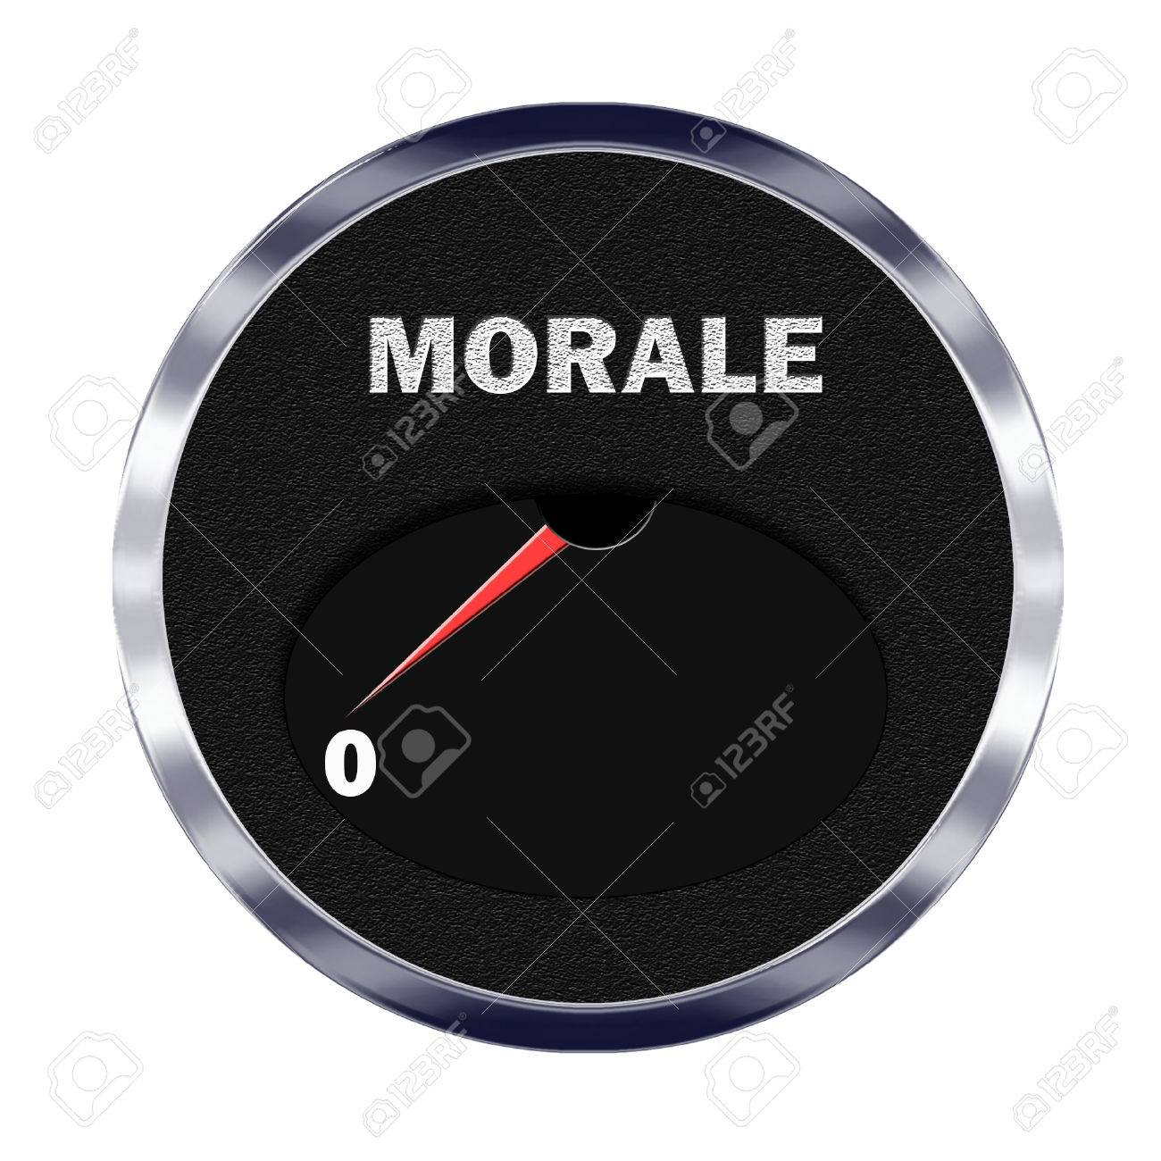
Low morale amongst workers
We heard from contributors that we face a growing emergency about the morale of staff working in social care.
Despite many in the workforce showing immense resilience overall, morale is low in adult social care, and care staff have felt undervalued compared with their healthcare counterparts.
This has also played out in practical terms, for example, in care workers not having priority access when shopping for their clients.
We were told about registered managers of adult social care services suffering from burn out and extreme anxiety.

Slide 31

Low morale amongst workers
Access to high-quality and trauma-informed support to managers and frontline staff to help them recover was seen as essential in the future.
In our engagement with our social workers, commissioners and care workers for Department of Health and Social Care-funded work on COVID-19, we were consistently told that many felt isolated and experienced very low morale during the first period of the pandemic.
In response, SCIE, along with other sector bodies like Skills for Care, established national forums and ‘meetup’ meetings which proved hugely popular, and we call on national bodies to continue putting on such groups.

Slide 32


10 minutes break

Slide 33
Glossary of different health care Perspectives
BMA: British Medical Association
CCG: Clinical Commissioning Groups
DCN: District Councils Network
DPH: Director of Public Health
GP: General Practitioner
HWB(s): Health and Wellbeing Board(s)
JSNA: Joint Strategic Needs Assessment
JHWS: Joint Health and Wellbeing Strategy
RCN: Royal College of Nursing
LSHTM: London School of Hygiene and Tropical Medicine
NHSE: NHS England
PCT: Primary Care Trust
PHE: Public Health England
PHOF: Public Health Outcomes Framework
PRUComm: Policy Research Unit in Commissioning and the Health Care System
UKFPH: UK Faculty of Public Health

Slide 34
WRAP-UP
Question and Answer Session

Slide 35
Capacity of hospitals and intensive care units
The COVID-19 pandemic has challenged and, in many cases, exceeded the capacity of hospitals and intensive care units (ICUs) worldwide.
Health-care workers have continued to provide care for patients despite exhaustion, personal risk of infection, fear of transmission to family members, illness or death of friends and colleagues, and the loss of many patients.
Sadly, health-care workers have also faced many additional—often avoidable—sources of stress and anxiety, and long shifts combined with unprecedented population restrictions, including personal isolation, have affected individuals' ability to cope.

Slide 36
Workforce supply gap
While the NHS is experiencing significant staffing pressures, the issues in social care are even greater and the outlook is concerning. One measure of the workforce supply gap is the vacancy rate.
This rose from 5.5% in 2012/13 to 7.8% in 2018/19, and 9.3% in London – the region with the highest rate.
The number of vacancies in social care in England is estimated to average 122,000 at any one time.
The long-term impact of COVID-19 on the health and social care workforce will take time to quantify and understand.
In the meantime, a comprehensive workforce plan for both the NHS and social care is needed now more than ever.

Slide 37
Healthcare workers at highest risk
During lockdowns, most essential workers are unable to protect themselves by working from home.
Furthermore, insufficient physical distancing is a leading contributor to any work related covid-19 outbreak.
Consequently, workers in sectors such as transport and social care are also at increased risk of covid-19, although healthcare workers have been shown repeatedly to be at highest risk.

Slide 38
Insufficient resources
Insufficient resources and the absence of specific treatments for COVID-19 added to the challenges of managing severely ill patients. Health-care workers had to care for colleagues who were ill, offer comfort to dying patients who were isolated from their loved ones, and inform and console patients' family members remotely.
Some health-care workers were burdened with emotionally and ethically fraught decisions about resource rationing and withholding resuscitation or ICU admission.
They shared the pain of patients without COVID-19 who had their surgery or other essential treatments cancelled or postponed.

Slide 39
Isolation from family members
The fear of transmitting COVID-19 led many health professionals to isolate from their families for months.
Working remotely and being shunned by community members further contributed to loneliness.
Many health-care workers experienced lost earnings because of cancellations in outpatient visits and elective procedures.
The training of health-care workers (e.g, medical students, residents, and allied health learners) was also interrupted, leading to loss of tuition fees, missed learning opportunities, missed exams, and potentially delayed certification.

Slide 40
Most, but not all, studies report increased risks for health workers caring for patients with covid-19.
31314 Working in intensive care units is not associated with an increased risk of infection, possibly owing to the protection afforded by high level PPE or to the decrease in infectivity that occurs in the later stages of the illness, even among critically ill patients.
1315 The greatest risk to healthcare workers may be their own colleagues or patients in the early stages of unsuspected infections when viral loads are high.12

Slide 41
The government’s Infection Control Fund, introduced in May to limit COVID-19 transmission in care homes, has been used by some providers to address this.
For example, 80% of Enfield’s allocation went towards paying staff while self-isolating. But this varied by local authority and may not have gone far enough.
In the Kent pulse survey in July, one in five workers who reported having to self-isolate had received little or no pay.
Additionally, some zero-hours workers may have missed out on pay because of increased childcare responsibilities or having to shield.

Slide 42
L0-1 Video Activity (20 minutes)
Working in pair with extracts from the below video clip,
Identify the difference between all Covid19 tests available
Pair feedback to the class
https://youtu.be/5hu7_xIsCRg

Slide 43
10 minutes break

Slide 44
ASSESSMENT SUBMISSION
Date assignment set | April 2021
Submission deadline date | 12th July 2021
Return date to students | 9th August 2021
All assignment will be submitted in electronic format and uploaded to LSC Portal on Turnitin

Slide 45
Assessment methods
The assessment Guide for Work Related Learning (WRL) has one (1) summative component:
Individual Report (weighted 100%)
Tasks to be completed (of not more than 2500 words)
Collate an individual report which assesses the health and social care sector, taking into account the current situation of the CoVid19 pandemic.
Explore how this has impacted the career prospects for health and social care.
Evaluate an organisation as an exemplar to justify your stand, by applying the theories and models learned from this module.

Slide 46
Karlsson, U. and Fraenkel, C., 2020. Covid-19: risks to healthcare workers and their families. BMJ, p.m3944.
https://www.health.org.uk/news-and-comment/charts-and-infographics/going-into-covid-19-the-health-and-social-care-workforce-faced-concerning-shortages
https://www.kingsfund.org.uk/projects/positions/nhs-workforce
https://www.kingsfund.org.uk/publications/covid-19-magnified-social-care-problems#workforce

